Slide 1
CS 6903 Network Security
Praveen Tammana
Based on Slides by D. Choffnes (NEU)

Slide 2
Layer 8 (The Carbon-based nodes)
If you want to…
Call someone, you need to ask for their phone number
You can’t just dial “P R O F M I S L O V E”
Mail someone, you need to get their address first
What about the Internet?
If you need to reach Google, you need their IP
Does anyone know Google’s IP?
Problem:
People can’t remember IP addresses
Need human readable names that map to IPs

Slide 3
Internet Names and Addresses
Addresses, e.g. 129.10.117.100
Computer usable labels for machines
Conform to structure of the network
Names, e.g. www.iith.ac.in
Human usable labels for machines
Conform to organizational structure
How do you map from one to the other?
Domain Name System (DNS)

Slide 4
History
Before DNS, all mappings were in hosts.txt
/etc/hosts on Linux
C:\Windows\System32\drivers\etc\hosts on Windows
Centralized, manual system
Changes were submitted to SRI via email
Machines periodically FTP new copies of hosts.txt
Administrators could pick names at their discretion
Any name was allowed
alans_server_at_neu_pwns_joo_lol_kthxbye

Slide 5
Towards DNS
Eventually, the hosts.txt system fell apart
Not scalable, SRI couldn’t handle the load
Hard to enforce uniqueness of names
e.g MIT
Massachusetts Institute of Technology?
Melbourne Institute of Technology?
Many machines had inaccurate copies of hosts.txt
Thus, DNS was born

Slide 6
Outline
DNS Basics
DNS Security

Slide 7
DNS at a High-Level
Domain Name System
Distributed database
No centralization
Simple client/server architecture
UDP port 53, some implementations also use TCP
Hierarchical namespace
As opposed to original, flat namespace
e.g. .com → google.com → mail.google.com

Slide 8
Naming Hierarchy
Root
net
edu
com
gov
mil
org
uk
fr
etc.
Top Level Domains (TLDs) are at the top
Maximum tree depth: 128
Each Domain Name is a subtree
.edu → neu.edu → ccs.neu.edu → www.ccs.neu.edu
Name collisions are avoided
neu.com vs. neu.edu
neu
mit
ccs
ece
husky
www
login
mail

Slide 9
Hierarchical Administration
Verisign
Root
ICANN
net
edu
com
gov
mil
org
uk
fr
etc.
Tree is divided into zones
Each zone has an administrator
Responsible for the part of the heirarchy
Example:
CCIS controls *.ccs.neu.edu
NEU controls *.neu.edu
neu
mit
ccs
www
login
mail

Slide 10
Server Hierarchy
Functions of each DNS server:
Authority over a portion of the hierarchy
No need to store all DNS names
Store all the records for hosts/domains in its zone
May be replicated for robustness
Know the addresses of the root servers
Resolve queries for unknown names
Root servers know about all TLDs
The buck stops at the root servers

Slide 11
Root Name Servers
Responsible for the Root Zone File
Lists the TLDs and who controls them
~272KB in size
com. 172800 IN NS a.gtld-servers.net.
com. 172800 IN NS b.gtld-servers.net.
com. 172800 IN NS c.gtld-servers.net.
Administered by ICANN
13 root servers, labeled A→M
6 are anycasted, i.e. they are globally replicated
Contacted when names cannot be resolved
In practice, most systems cache this information

Slide 12
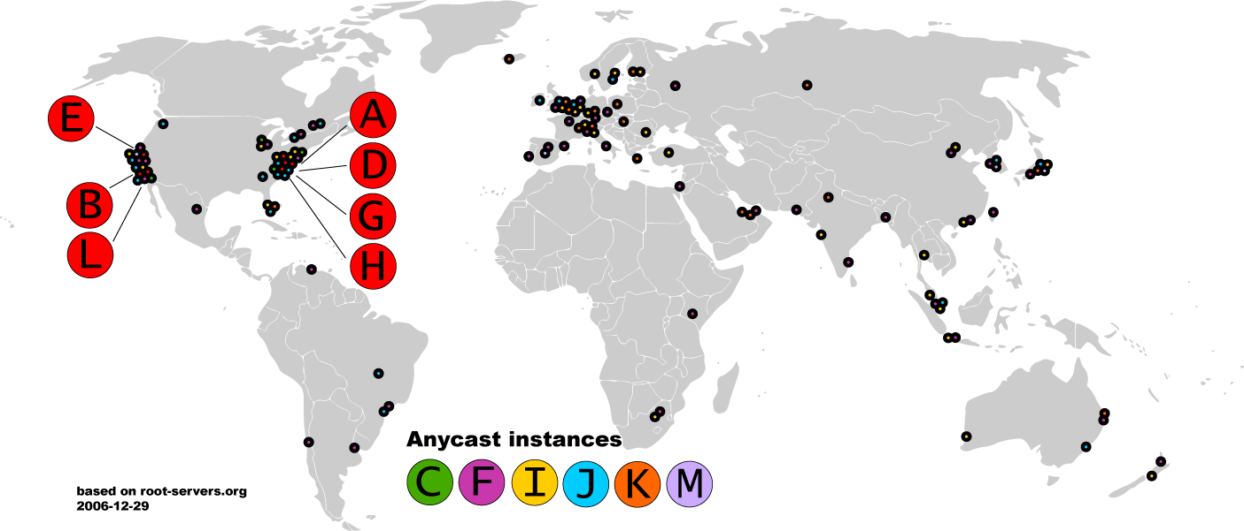
Map of the Roots

Slide 13


Local Name Servers
Where is google.com?
Northeastern
Each ISP/company has a local, default name server
Often configured via DHCP
Hosts begin DNS queries by contacting the local name server
Frequently cache query results

Slide 14
Authoritative Name Servers
www.neu.edu = 155.33.17.68
Where is www.neu.edu?
www.neu.edu
Northeastern
Root
edu
neu
Authority for ‘edu’
Authority for ‘neu.edu’
Stores the name→IP mapping for a given host

Slide 15
Basic Domain Name Resolution
Every host knows a local DNS server
Sends all queries to the local DNS server
If the local DNS can answer the query, then you’re done
Local server is also the authoritative server for that name
Local server has cached the record for that name
Otherwise, go down the hierarchy and search for the authoritative name server
Every local DNS server knows the root servers
Use cache to skip steps if possible
e.g. skip the root and go directly to .edu if the root file is cached

Slide 16
Recursive DNS Query
www.google.com
Where is www.google.com?
Puts the burden of resolution on the contacted name server
How does asgard know who to forward responses too?
Random IDs embedded in DNS queries
What have we said about keeping state in the network?
asgard.ccs.neu.edu
ns1.google.com
com
Root

Slide 17
Iterated DNS query
www.google.com
Where is www.google.com?
Contact server replies with the name of the next authority in the hierarchy
“I don’t know this name, but this other server might”
This is how DNS works today
asgard.ccs.neu.edu
ns1.google.com
com
Root

Slide 18
DNS Propagation
How many of you have purchased a domain name?
Did you notice that it took ~72 hours for your name to become accessible?
This delay is called DNS Propagation
www.my-new-site.com
Root
com
asgard.ccs.neu.edu
ns.godaddy.com
Why would this process fail for a new DNS name?

Slide 19
Caching vs. Freshness
DNS Propagation delay is caused by caching
Where is
www.my-new-site.com?
That name does not exist.
Cached Root Zone File
Cached .com Zone File
Cached .net Zone File
Etc.
asgard.ccs.neu.edu
Zone files may be cached for 1-72 hours
Root
com
www.my-new-site.com
ns.godaddy.com

Slide 20
DNS Resource Records
DNS queries have two fields: name and type
Resource record is the response to a query
Four fields: (name, value, type, TTL)
There may be multiple records returned for one query
What are do the name and value mean?
Depends on the type of query and response

Slide 21
DNS Types
Type = A / AAAA
Name = domain name
Value = IP address
A is IPv4, AAAA is IPv6
Type = NS
Name = partial domain
Value = name of DNS server for this domain
“Go send your query to this other server”
Name: www.ccs.neu.edu
Type: A
Query
Name: www.ccs.neu.edu
Value: 129.10.116.81
Resp.
Name: ccs.neu.edu
Type: NS
Query
Name: ccs.neu.edu
Value: 129.10.116.51
Resp.

Slide 22
DNS Types, Continued
Type = CNAME
Name = hostname
Value = canonical hostname
Useful for aliasing
CDNs use this
Type = MX
Name = domain in email address
Value = canonical name of mail server
Name: foo.mysite.com
Type: CNAME
Query
Name: foo.mysite.com
Value: bar.mysite.com
Resp.
Name: ccs.neu.edu
Type: MX
Query
Name: ccs.neu.edu
Value: amber.ccs.neu.edu
Resp.

Slide 23
Reverse Lookups
What about the IP→name mapping?
Separate server hierarchy stores reverse mappings
Rooted at in-addr.arpa and ip6.arpa
Additional DNS record type: PTR
Name = IP address
Value = domain name
Not guaranteed to exist for all IPs
Name: 129.10.116.51 Type: PTR
Query
Name: 129.10.116.51 Value: ccs.neu.edu
Resp.

Slide 24
DNS as Indirection Service
DNS gives us very powerful capabilities
Not only easier for humans to reference machines!
Changing the IPs of machines becomes trivial
e.g. you want to move your web server to a new host
Just change the DNS record!

Slide 25
Aliasing and Load Balancing
One machine can have many aliases
www.reddit.com
david.choffnes.com
www.foursquare.com
alan.mislo.ve
www.huffingtonpost.com
*.blogspot.com
One domain can map to multiple machines
www.google.com

Slide 26
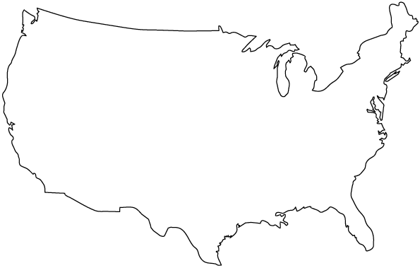


Content Delivery Networks
DNS responses may vary based on geography, ISP, etc

Slide 27
Outline
DNS Basics
DNS Security

Slide 28
The Importance of DNS
Without DNS…
How could you get to any websites?
You are your mailserver
When you sign up for websites, you use your email address
What if someone hijacks the DNS for your mail server?
DNS is the root of trust for the web
When a user types www.bankofamerica.com, they expect to be taken to their bank’s website
What if the DNS record is compromised?

Slide 29
Denial Of Service
Flood DNS servers with requests until they fail
October 2002: massive DDoS against the root name servers
What was the effect?
… users didn’t even notice
Root zone file is cached almost everywhere
More targeted attacks can be effective
Local DNS server → cannot access DNS
Authoritative server → cannot access domain

Slide 30

DNS Hijacking
Infect their OS or browser with a virus/trojan
e.g. Many trojans change entries in /etc/hosts
*.bankofamerica.com → evilbank.com
Man-in-the-middle
Response Spoofing
Eavesdrop on requests
Outrace the servers response

Slide 31
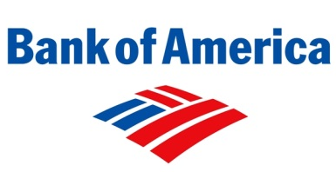


DNS Spoofing
Where is bankofamerica.com?
123.45.67.89
How do you know that a given name→IP mapping is correct?
Where is bankofamerica.com?
dns.bofa.com
66.66.66.93
123.45.67.89
dns.evil.com
66.66.66.93

Slide 32
DNS Cache Poisoning
Where is www.google.com?
Where is bankofamerica.com?
www.google.com = 74.125.131.26
dns.neu.edu
ns1.google.com
Until the TTL expires, all queries for BofA to dns.neu.edu will return poisoned result
Much worse than spoofing/man-in-the-middle
Whole ISPs can be impacted!
bankofamerica.com = 66.66.66.92

Slide 33
Solution: DNSSEC
Cryptographically sign critical resource records
Resolver can verify the cryptographic signature
Two new resource types
Type = DNSKEY
Name = Zone domain name
Value = Public key for the zone
Type = RRSIG
Name = (type, name) tuple, i.e. the query itself
Value = Cryptographic signature of the query results
Deployment
On the roots since July 2010
Verisign enabled it on .com and .net in January 2011
Comcast is the first major ISP to support it (January 2012)
Creates a hierarchy of trust within each zone
Prevents hijacking and spoofing

Slide 34
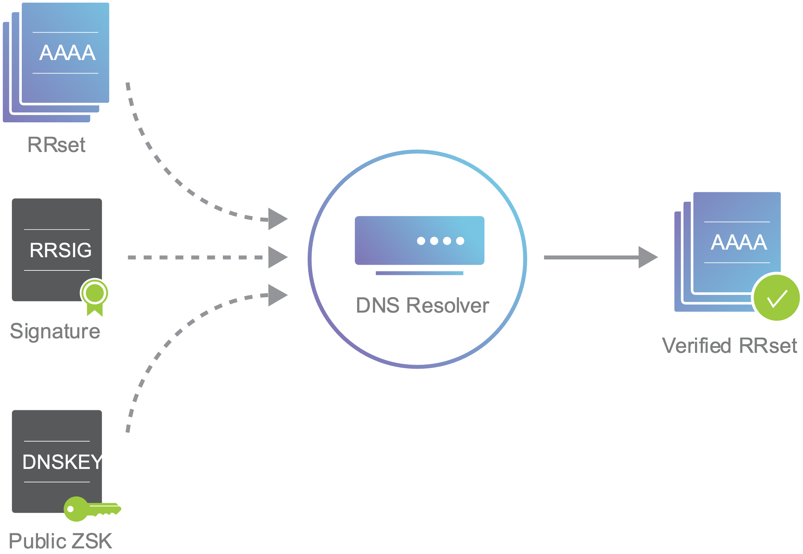
Notes:
- Each zone in DNSSEC has a zone-signing key pair (ZSK): the private portion of the key digitally signs each RRset in the zone, while the public portion verifies the signature. To enable DNSSEC, a zone operator creates digital signatures for each RRset using the private ZSK and stores them in their name server as RRSIG records. This is like saying, “These are my DNS records, they come from my server, and they should look like this.” - However, these RRSIG records are useless unless DNS resolvers have a way of verifying the signatures. The zone operator also needs to make their public ZSK available by adding it to their name server in a DNSKEY record. - When a DNSSEC resolver requests a particular record type (e.g., AAAA), the name server also returns the corresponding RRSIG. The resolver can then pull the DNSKEY record containing the public ZSK from the name server. Together, the RRset, RRSIG, and public ZSK can validate the response.

Slide 35
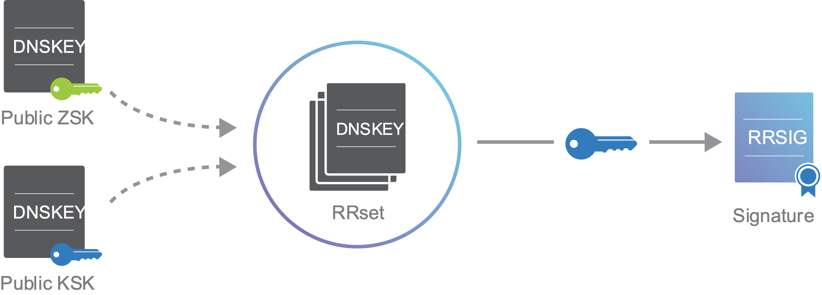
Notes:
Key-Signing Keys
In addition to a zone-signing key, DNSSEC name servers also have a key-signing key (KSK). The KSK validates the DNSKEY record in exactly the same way as our ZSK secured the rest of our RRsets in the previous section: It signs the public ZSK (which is stored in a DNSKEY record), creating an RRSIG for the DNSKEY.
Just like the public ZSK, the name server publishes the public KSK in another DNSKEY record, which gives us the DNSKEY RRset shown in the earlier slide. Both the public KSK and public ZSK are signed by the private KSK. Resolvers can then use the public KSK to validate the public ZSK. Validation for resolvers now looks like this:
Request the desired RRset, which also returns the corresponding RRSIG record.
Request the DNSKEY records containing the public ZSK and public KSK, which also returns the RRSIG for the DNSKEY RRset.
Verify the RRSIG of the requested RRset with the public ZSK.
Verify the RRSIG of the DNSKEY RRset with the public KSK.
We’ve now established trust within our zone, but DNS is a hierarchical system, and zones rarely operate independently. Complicating things further, the key-signing key is signed by itself, which doesn’t provide any additional trust. We need a way to connect the trust in our zone with its parent zone.

Slide 36

DNSSEC Hierarchy of Trust
Root Zone (ICANN)
.com (Verisign)
IP: 123.45.67.89
Key: < >
SIG: x9fnskflkalk
IP: 66.66.66.93
Key: < >
SIG: 9na8x7040a3
Where is bankofamerica.com?
dns.bofa.com
dns.evil.com
Notes:
- DNSSEC introduces a delegation signer (DS) record to allow the transfer of trust from a parent zone to a child zone. A zone operator hashes the DNSKEY record containing the public KSK and gives it to the parent zone to publish as a DS record.
- Every time a resolver is referred to a child zone, the parent zone also provides a DS record. This DS record is how resolvers know that the child zone is DNSSEC-enabled. To check the validity of the child zone’s public KSK, the resolver hashes it and compares it to the DS record from the parent. If they match, the resolver can assume that the public KSK hasn’t been tampered with, which means it can trust all of the records in the child zone. This is how a chain of trust is established in DNSSEC.

Slide 37
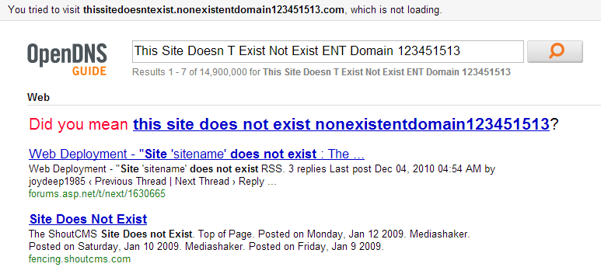
Site Finder
September 2003: Verisign created DNS wildcards for *.com and *.net
Essentially, catch-all records for unknown domains
Pointed to a search website run by Verisign
Search website was full of advertisements
Extremely controversial move
Is this DNS hijacking?
Definitely abuse of trust by Verisign
Site Finder was quickly shut down, lawsuits ensued

Slide 38
Much More to DNS
Caching: when, where, how much, etc.
Other uses for DNS (i.e. DNS hacks)
Content Delivery Networks (CDNs)
Different types of DNS load balancing
Dynamic DNS (e.g. for mobile hosts)
DNS and botnets
Politics and growth of the DNS system
Governance
New TLDs (.xxx, .biz), eliminating TLDs altogether
Copyright, arbitration, squatting, typo-squatting

